Slide 1
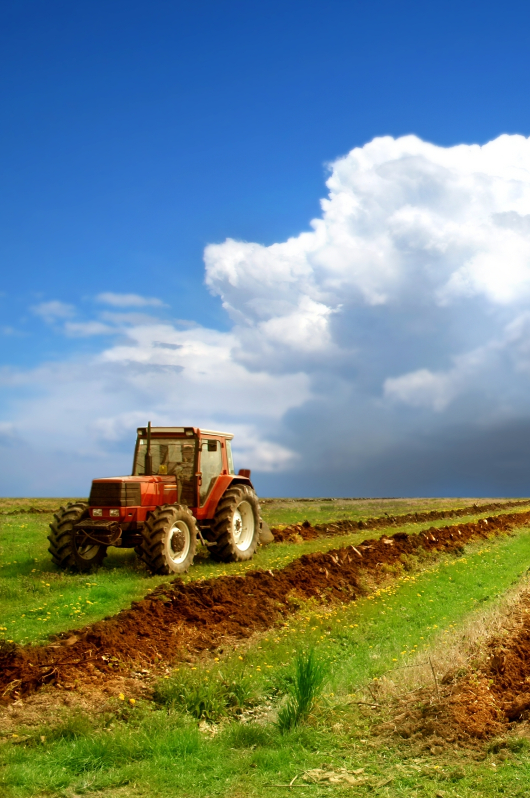

Farmer Assistance: Empowering the Agricultural Community
Farmer Assistance is a comprehensive platform designed to support farmers and agricultural communities.
It provides a range of tools and resources to enhance efficiency, productivity, and profitability in the agricultural sector.
The platform leverages cutting-edge technology to address the challenges faced by modern farmers.

Slide 2


Introduction to Farmer
Assistance
Personalized Support
Farmer Assistance provides farmers with personalized support through its suite of tools and resources, tailored to individual needs.
Enhanced Productivity
The platform helps farmers optimize their operations, leading to increased yields and better resource management.
Improved Decision-Making
By providing access to timely information and insights, Farmer Assistance facilitates informed decision-making.
Financial Stability
The platform empowers farmers to enhance profitability and financial stability through improved efficiency and resource optimization.

Slide 3


Chatbot for Farmers: Personalized Assistance at Your Fingertips
24/7 Accessibility
The chatbot is available around the clock, providing farmers with instant assistance whenever they need it.
Personalized Guidance
The chatbot leverages AI and machine learning to provide tailored guidance and support based on individual farm characteristics.
Practical Advice
The chatbot offers practical advice on a wide range of topics, from crop management and pest control to marketing and finance.

Slide 4
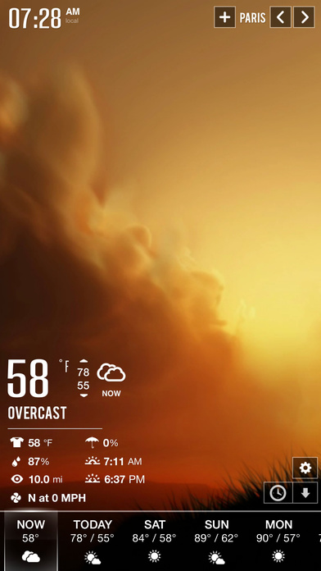

Real-Time Weather Forecasting: Staying Ahead of the Elements
1
Data Collection
The platform gathers data from a network of weather stations and satellites to provide accurate and up-to-date weather forecasts.
2
Processing and Analysis
Advanced algorithms process the weather data to generate precise and localized forecasts for specific farming regions.
3
Delivery to Farmers
Farmers receive customized weather alerts and forecasts directly to their mobile devices, ensuring timely information for decision-making.

Slide 5
Integrating Weather Data: Leveraging Cutting-Edge Technology
Data Integration
Predictive Analytics
Smart Decision Support
The platform seamlessly integrates weather data with other relevant information, such as crop type, soil conditions, and historical trends.
By analyzing weather patterns and historical data, Farmer Assistance provides farmers with insights to anticipate and prepare for potential challenges.
The integrated weather data empowers farmers to make informed decisions regarding irrigation, fertilization, and pest control.

Slide 6


Farmer Feedback and Testimonials
Testimonial 1
"Farmer Assistance has been a game-changer for my farm. The chatbot has saved me countless hours and the real-time weather forecasts have helped me make informed decisions."
Testimonial 2
"I used to struggle with unpredictable weather, but now with the help of Farmer Assistance, I am able to adapt and optimize my operations based on accurate forecasts."
Testimonial 3
"The platform has improved my overall productivity and profitability. I highly recommend it to any farmer looking to enhance their operations."

Slide 7





Roadmap for Future Enhancements
Advanced Analytics
Developing advanced analytical tools to provide farmers with deeper insights and predictive capabilities.
Market Intelligence
Integrating market data to provide farmers with information on commodity prices, demand trends, and potential buyers.
Precision Agriculture
Exploring the integration of precision agriculture technologies to optimize resource use and increase yields.

Slide 8


Conclusion and Call to Action
Farmer Assistance is a powerful tool that empowers farmers to thrive in a challenging and dynamic agricultural environment. We encourage all farmers to explore the platform and harness its resources to enhance their operations and achieve success.

